Slide 1


Slide 2


Coetzee’s Major Works and Lizzie’s golden opinion on them.

Slide 3
TABLE OF CONTENTS
Introduction
Major Works
01
02
Special Thanks
Conclusion
04
03
A Short Biography of J.M Coetzee
In the Heart of the country
Waiting for the Barbarians
Disgrace
Me

Slide 4

01

Slide 5
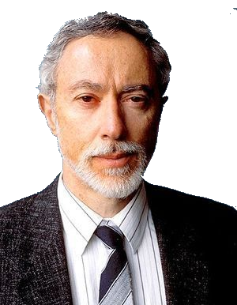
A short biography of J.M. Coetzee
John Maxwell Coetzee, famous South Africa author.
- Born in South Africa
- Winner of 2003 Nobel Prize of literature
- Currently lives in Adelaide, SA

Slide 6

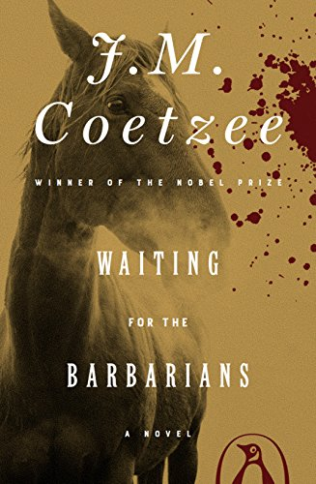

Major Works
- The narrator, Magda, tells the story
- Written in the form of a diary
- Had a film adaptation
- Colonialist empire against ‘barbarians’
- Criticizes colonialism
- Colonialist empire against ‘barbarians’
- Criticizes colonialism

Slide 7



Did not change my view on Africa
Still discredits racist stereotypes

Slide 8


To Coetzee for existing, to me for making this presentation, and to YOU for listening!
GIFs by Lizzie

